Slide 1
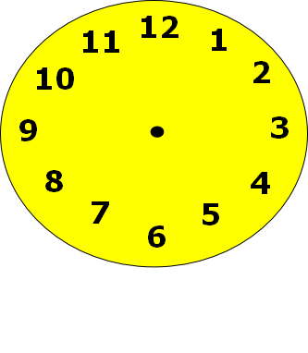
Half past
Telling the time

Slide 2
What time is it?
Half past 1
Half past 12
Half past 2

Slide 3
Try again

Slide 4
Well done!
Play again

Slide 5
What time is it?
Half past 4
Half past 5
Half past 12

Slide 6
Try again

Slide 7
Well done!
Play again

Slide 8
What time is it?
Half past 12
Half past 9
Half past 8

Slide 9
Try again

Slide 10
Well done!
Play again

Slide 11
What time is it?
Half past 7
Half past 8
Half past 6

Slide 12
Try again

Slide 13
Well done!
Play again

Slide 14
What time is it?
Half past 1
Half past 3
Half past 6

Slide 15
Try again

Slide 16
Well done!
Play again

Slide 17
What time is it?
Half past 11
Half past 6
Half past 12

Slide 18
Try again

Slide 19
Well done!
Play again

Slide 20
What time is it?
Half past 8
Half past 6
Half past 4

Slide 21
Try again

Slide 22
Well done!
Press here for a certificate

Slide 23
Well done! You can read ‘half past’ times.
Awarded to:_ _ _ _ _ _ _ _ _ _ _ _ _ _

